Slide 1
ECHOCARDIOGRAPHY …From a Sonographer’s Perspective THE NOTEBOOK 8 Chapter IVb: DIASTOLOGY & MORE!
Susan King DeWitt, BS, RDCS, RCS

Slide 2
COPYRIGHT INFRINGEMENT IS A SERIOUS CRIME.
Please respect my U.S. Copyright & hard work—do not copy/distribute/edit.
Copyright © 1996, 2002, 2009, 2010, 2011, 2018, 2022. All rights reserved. Library of Congress Catalog Card Numbers: TX0006951179 and TX0008635753.
No part of this publication may be published, shared, edited, voiced over, reproduced, stored in a retrieval system, or transmitted, in any form or by any means, electronic, mechanical, photocopying, recording, or otherwise.
The information in this material is designed to provide education in the field of echocardiography and related topics. It was written, edited, and published by Susan King DeWitt, Author, LLC—a registered cardiac sonographer, not a physician, professional editor, or publishing company. This material does not guarantee a passing grade on the registry exam(s); however, it does discuss most of the test material. References provided do not constitute endorsement of any websites or other sources. Readers should be aware the information and websites listed may change.

Slide 3
ECHO…THE NOTEBOOK 8 & THE WORKBOOK 8
are currently approved by the
Society of Diagnostic Medical Sonography (SDMS)
as a self-instructional activity for
31 CME CREDITS
Please refer to www.echonotebook.com for more details!

Slide 4
IVb. DIASTOLOGY & MORE!
OBJECTIVES
Upon completion of this section, the reader will be able to:
Acquire and interpret the left and right ventricular diastolic function parameters.
Discuss an agitated saline study to include the indications, acquisition, and procedure.
Identify the sonographer’s role plus the indications, primary goal, and artifacts of the UEA.
Recognize, define, and acquire M-mode dimensions.

Slide 5
LV DIASTOLIC
FUNCTION

Slide 6
POP QUIZ!
What is diastolic dysfunction?
LV DIASTOLIC FUNCTION
SONOGRAPHER’S ROLE watch for impaired LV relaxation, reduced restoring forces & increased diastolic stiffness estimate LV filling pressure evaluate HR, rhythm, BP, EF & MV disease acquire LVV, LV wall thickness, Doppler patterns at multiple sites & LAV evaluate those with potential diastolic dysfunction, dyspnea & HF echo report → LV filling pressure, grade of diastolic dysfunction & comparison with previous echo
According to the ASE Guidelines, LV diastolic dysfunction is usually the result of impaired LV relaxation with or without
reduced restoring forces (& early diastolic suction) & increased LV chamber stiffness—which increase cardiac filling pressures.

Slide 7
Who is exempt?
Suboptimal vs optimal Doppler signals…what to measure?
What is a normal filling pattern in an elderly patient?
TIPS

Slide 8
(1 – 14) LV DIASTOLIC FUNCTION PARAMETERS
MITRAL INFLOW | (1) E-wave peak velocity (2) A-wave peak velocity (3) E/A ratio (4) E-wave DT (5) A-wave duration
TDI OF MITRAL ANNULUS | (6) e’-wave peak velocity (7) E/e’ ratio
LAVi | (8) LAVi
PV4 FLOW | (9) S-wave peak velocity (10) D-wave peak velocity (11) AR duration (12) S/D ratio
PEAK TRV | (13) peak TRV
VALSALVA MANEUVER | (14) observe MV E-wave, A-wave & E/A ratio

Slide 9
(1 – 5) MITRAL INFLOW
METHOD 4C lateral swing with posterior tilt PWD increase sweep speed | PROTOCOL (1) E-wave peak velocity (2) A-wave peak velocity (3) E/A ratio (1 - 1.5) (4) E-wave DT (160 - 240 ms) (5) A-wave duration
POP QUIZ!
Where should the PWD gate be positioned & what sample size?

Slide 10
POP QUIZ!
Calculate the E/A ratios.
A B

Slide 11
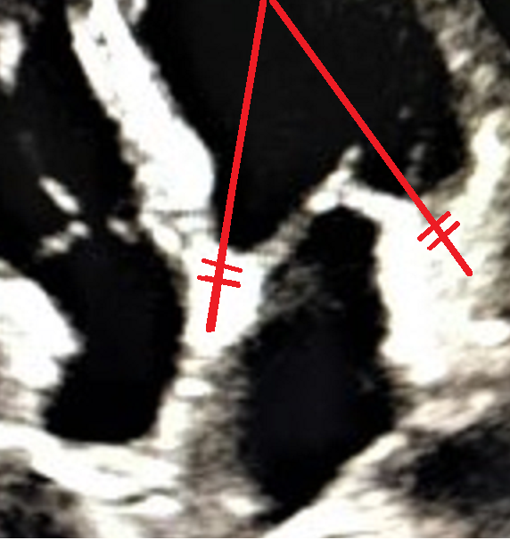
(6 – 7) TDI OF MITRAL ANNULUS
METHOD 4C TDI mode gate at mitral annulus lat wall sep wall (except…?) avg lat & sep wall | PROTOCOL (6) e’-wave peak velocity (7) E/e’ ratio
POP QUIZ!
What does TDI of the mitral annulus measure
& what is it a mirror image of?
POP QUIZ!
What does an E/e’ < 8 indicate?
What does an E/e’ > 14 indicate?

Slide 12
POP QUIZ!
Calculate the E/e’ ratios.
A B
MV E = 1.5 m/s MV E = 0.8 m/s TDI e’ = 0.15 m/s TDI e’ = 0.07 m/s

Slide 13
(8) LAVi
DEFINITION LAVi = LAV indexed to BSA = LAV/BSA represents cumulative effect of increased LV filling pressure increased LAVi: predicts outcome reflects increased LAP (in absence of MV disease) sign of diastolic dysfunction sign of LAP severity & chronicity
POP QUIZ!
Despite normal LV diastolic
function, when can LAE occur?
LAE SEVERITY SCALE
DEGREE OF LAE | LAVi (mL/m²)
NORMAL LAV | 16 - 34
MILD | 35 - 41
MOD | 42 - 48
SEVERE | > 48

Slide 14
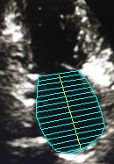
LAVi
METHOD & PROTOCOL (8) LAVi 4C & 2C zoom & maximize planimeter 4C & 2C end (ventricular) systole exclude LAA, PV4 inlets & area just beneath MV acquire 4C & 2C end (ventricular) systole length | BIPLANE METHOD OF DISKS (preferred)
BIPLANE AREA-LENGTH METHOD
POP QUIZ!
What are potential causes of inaccurate LA measurements?

Slide 15
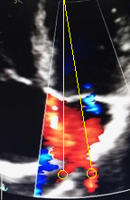
(9 – 12) PV4 FLOW
METHOD use as a supplement 4C/5C CFD PWD small gate (1 - 3 mm) gate ~ 1 - 2 cm into PV4 increase sweep speed | PROTOCOL (9) S-wave peak velocity (10) D-wave peak velocity (11) S/D ratio (0.7 - 1.2) (12) AR wave duration (150 ms)
POP QUIZ!
Identify the PV4 by name in the 4C vs 5C?

Slide 16
POP QUIZ!
Is this a normal waveform?

Slide 17
(13) PEAK TRV
METHOD & PROTOCOL (13) peak TRV compare views utilize CFD to locate TR jet, optimize Doppler angle & place CWD focus within jet acquire peak TRV (abnormal cut-off > 2.8 m/s) ? filling in adequately | TR & RVSP in absence of RVOTO, peak TRV & mean RAP are used to estimate RVSP & assess PH RVSP = SPAP RVSP = indirect LAP estimate in absence of pulmonary vascular disease, an elevated RVSP indicates an elevated LAP & can identify increased LV filling pressure

Slide 18
POP QUIZ!
What is the peak TRV &
is it within normal limits?

Slide 19
(14) VALSALVA MANEUVER
NOTES sometimes LV filling appears normal decreased diastolic compliance + increased LV filling pressure = pseudonormal mitral inflow utilize Valsalva to unmask abnormal filling & help determine if restrictive filling pattern is reversible or not if normal, E/A remains normal (> 1) if pseudonormal, E/A becomes abnormal (< 1) | PROTOCOL (14) Valsalva maneuver strain phase release phase Suspect elevated LV filling pressure?
POP QUIZ!
Describe what is happening to the mitral inflow
before & after Valsalva maneuver.

Slide 20
So, how do we interpret the findings???
If LVEF is normal → use CHART #1!
If LVEF is reduced,
or normal with myocardial disease→ use CHART #2!

Slide 21
CHART #1 - If LVEF is normal… assess four key parameters
1) TDI of MV annulus peak e’-wave (sep wall) < 7 cm/s or peak e’-wave (lat wall) < 10 cm/s 2) E/e’ ratio E/e’ (avg lat & sep wall) > 14 E/e’ (lat wall) > 13 E/e’ (sep wall) > 15 3) LAVi > 34 mL/m² 4) Peak TRV > 2.8 m/s | REPORT If < 2 of the four parameters are positive, report NORMAL diastolic function. If 2 of the four parameters are positive, report INCONCLUSIVE diastolic function. If > 2 of the four parameters are positive, report DIASTOLIC DYSFUNCTION.
For additional info and scenarios, please refer to the ASE/EACVI Guidelines and Standards; J Am Soc Echocardiogr 2016; 29:277-314

Slide 22
CHART #2 - If LVEF is reduced, or normal with myocardial disease… E/A ratio can usually predict elevated LAP E-wave DT is a key predictor of outcome |  | REPORT DIASTOLIC DYSFUNCTION
1) If E/A ≤ 0.8 with E-wave ≤ 50 cm/s, then LAP is normal or low |  | GRADE I
2) If E/A ≤ 0.8 with E-wave > 50 cm/s or if E/A is between 0.8 - 2, assess three additional parameters: E/e’ (avg lat & sep wall) > 14 peak TRV > 2.8 m/s LAVi > 34 mL/m² | If 2 or 3 of the three additional parameters are negative, then LAP is normal. | GRADE I
 | If 2 or 3 of the three additional parameters are positive, then LAP is elevated. | GRADE II
3) If E/A ≥ 2, then LAP is elevated |  | GRADE III
For additional info and scenarios, please refer to the ASE/EACVI Guidelines and Standards; J Am Soc Echocardiogr 2016; 29:277-314

Slide 23
If LVEF = 40%
use CHART #2
If E/A ratio = 1.6
use (#2) + three additional parameters
Finally, if the three additional parameters are
E/e’ (avg lat & sep wall) = 16 (> 14, abnormal)
peak TRV = 3 m/s (> 2.8 m/s, abnormal)
LAVi = 40 mL/m² (> 34 mL/m², abnormal)
then, what should be reported?
POP QUIZ!

Slide 24
RV DIASTOLIC FUNCTION
AGITATED SALINE STUDY
UEA
M-MODE DIMENSIONS

Slide 25
RV DIASTOLIC FUNCTION
INTRO acute vs chronic pressure/volume overload pulmonary disease IHD CHD CMO LV disease consider acquiring parameters if known or suspected RV impairment | PARAMETERS 1) Tricuspid inflow peak E-wave & A-wave E/A ratio DT 2) TDI of tricuspid annulus E/e’ ratio 3) RAV & RAP | INTERPRETATION E/A < 0.8 → impaired relaxation E/A between 0.8 - 2.1 with E/e’ > 6 or predominant diastolic flow in hepatic veins → pseudonormal filling E/A > 2.1 with DT < 120 ms → restrictive filling
POP QUIZ!
Who is excluded from RV diastolic calculations?

Slide 26


AGITATED SALINE STUDY
INDICATIONS aka bubble study not routine, keep available interatrial shunt intrapulmonary shunt persistent left SVC SUPPLIES IV access, syringes, lockable triple stopcock & saline good imaging windows | ACQUISITION enable tissue harmonic imaging acquire ~ 20+ consecutive beats ? number of heartbeats for bubbles → LA or CS PROCEDURE IV access draw up normal saline plus ≤ 0.5 mL air briskly agitate rapidly inject if needed, try a different approach or repeat with a maneuver to increase RAP

Slide 27
UEA
RESPONSIBILITIES integral part of TTE lab needs established protocol sonographer → understand indications, recognize need, be prepared & practice image optimization INDICATION unable to distinguish endocardial motion of 2+ contiguous segments in any of the apical views → UEA other common uses…
According to the 2019 ASE Guidelines, the only FDA approved UEA indication is to opacify the LV chamber & improve delineation of LV endocardial border.

Slide 28
UEA
ADMINISTRATION & ARTIFACT IV bolus continuous infusion—reduces artifact attenuation swirling adjust amount/rate to avoid artifact artifact improves as concentration decreases TTE IMAGES apical views → first parasternal views → last
POP QUIZ!
In general, what is the
primary goal of the UEA?

Slide 29
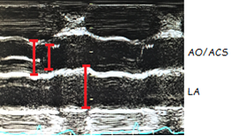
M-MODE MEASUREMENTS
PROTOCOL on-axis ? steerable L - L technique | RV & LV RVFWd, RVd, IVSd, LVIDd, PWTd (end diastole) IVSs, LVIDs, PWTs (end systole)
 | AO ROOT & LA AO root (end diastole) ACS (early systole) LA (end systole)

Slide 30
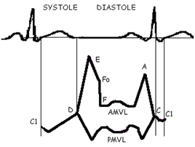
MV M-MODE
MV DEFINITIONS
D to Fo - rapid filling
Fo to first upward movement of “A” kick - slow filling
first upward movement of “A” kick to C - atrial ejection
C to C1 – IVCT prior to onset of mechanical systole
C1 - beginning of systole

Slide 31
MV M-MODE
MV MEASUREMENTS (1) EF slope (70 - 150 mm/sec) (2) D-E excursion (18 - 28 mm) (3) EPSS (2 - 7 mm) (4) MV closes immediately following QRS (premature closure of MV → increased LVEDP) (5) B bump between A & C → increased LVEDP
POP QUIZ!
What does an
EPSS > 20 mm indicate?

